Slide 1

CSE523 : Machine Learning | The Overfitters
Identifying hard stop & momentary stop using vehicle trajectory dataset
Vishesh Bhatia
AU2240027
Jay Raval
AU2240151
Jinil Savaj
AU2240159
Karan Prajapati
AU2240161
Meet Suthar
AU2240198
1

Slide 2

Problem Statement
Given a dataset containing extracted vehicle trajectories at a signalized intersection to analyze different stopping behaviors.
At intersections, we assume drivers follow traffic signals, leading to vehicles stopping and restarting at red lights, which we classify as a momentary stop.
Some vehicles remain stationary for an extended period, such as parked vehicles, representing a hard stop.
There are vehicles that continue moving without stopping, categorized as moving vehicles.
Our objective is to develop a machine learning model to accurately distinguish between these three conditions using trajectory data.
2

Slide 3
Literature Survey
Author | Published Year | Publication Title | Key Findings
V. Patel, M. Maleki, Mehdi Kargar, J. Chen, and H. Maoh | June. 2022 | A cluster-driven classification approach to truck stop location identification using passive GPS data | DBSCAN clustering for stop identification, feature-based classification, Random Forest classifier achieving 97% accuracy for primary stops, 83% overall accuracy, and 92% prediction accuracy for primary stops.
Negin Masnabadi, Farhad Hosseinali, and Zahra Bahramian | October. 2021 | Developing a spatial and temporal density-based clustering algorithm to extract stop locations from the user’s trajectory | Enhanced DBSCAN with spatial-temporal indices, solved round trip issue, improved cluster detection, and achieved 94.06% accuracy in identifying holidays.
3

Slide 4
Dataset Discussion
Initial Dataset Without Correction
frameNo | trackID | left | top | w | h
1 | 155 | 2019 | 417 | 63 | 30
1 | 154 | 2018 | 376 | 61 | 30
1 | 153 | 949 | 1267 | 56 | 51
1 | 152 | 1426 | 1596 | 71 | 54
1 | 151 | 2466 | 1534 | 38 | 40
1 | 150 | 337 | 0 | 63 | 48
1 | 149 | 1462 | 846 | 82 | 54
1 | 148 | 1855 | 128 | 62 | 36
1 | 147 | 2023 | 1035 | 38 | 32
frameNo: Represents the frame number in the video sequence. Each frame corresponds to a single image captured at a specific timestamp.
trackID: A unique identifier assigned to each detected vehicle. Useful for tracking the trajectory of each vehicle over time.
left: The x-coordinate (in pixels) of the top-left corner of the vehicle’s bounding box.
top: The y-coordinate (in pixels) of the top-left corner of the vehicle’s bounding box.
w (width): The width of the bounding box (in pixels).
h (height): The height of the bounding box (in pixels).
4

Slide 5
Dataset Discussion
Final Dataset With Correction
Center X | Center Y | Overall CLS | Distance | Velocity | Acceleration | Speed | Avg Velocity 50 | Avg Velocity 100
250 | 1027.5 | Car | 1000.04 | 2.45 | NaN | 25.26 | 3.0048 | 3.1587
256.5 | 1026.5 | Car | 998.58 | -1.46 | -3.92 | 23.68 | 3.0176 | 3.632
265.5 | 1027.5 | Car | 1002.29 | 3.72 | 5.18 | 32.6 | 3.1547 | 3.562
...... | ...... | ...... | ...... | ...... | ...... | ...... | ...... | ......
...... | ...... | ...... | ...... | ...... | ...... | ...... | ...... | ......
273 | 1028 | Car | 1003.76 | 1.47 | -2.25 | 27.06 | 3.1341 | 3.0058
280 | 1027.5 | Car | 1005.29 | 1.53 | 0.06 | 25.26 | 3.1696 | 3.8912
304 | 1028.5 | Car | 1011.22 | 0.52 | -2.32 | 27.24 | 3.1578 | 3.7541
Center X / Center Y: Represent the position coordinates of the vehicle in the frame.
Overall CLS: Identifies the type of object.
Distance: Represents the distance covered by the vehicle.
Velocity: Measures the vehicle's current speed at a given moment.
Acceleration: Tracks changes in velocity, which helps in identifying sudden stops or quick acceleration.
Speed: Similar to velocity but represent average speed or filtered values.
Avg Velocity 50 / Avg Velocity 100: Represent averaged velocity readings over the last 50 and 100 samples, respectively, providing smoother data trends.
5

Slide 6
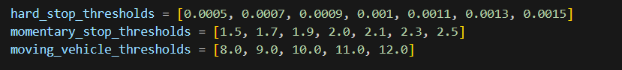
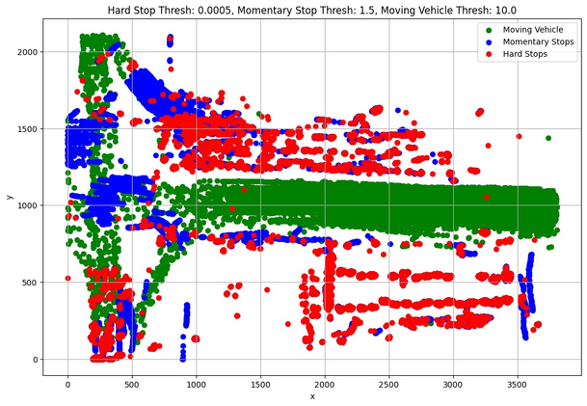
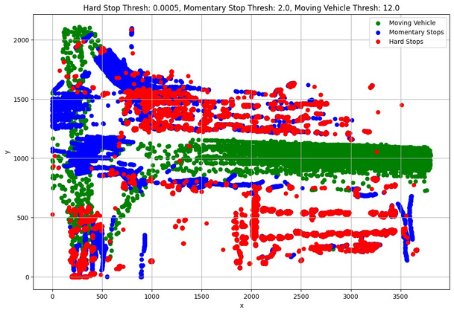
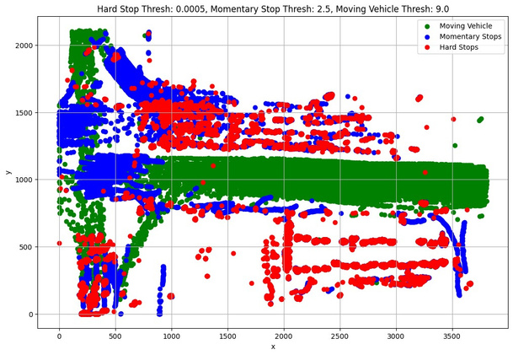
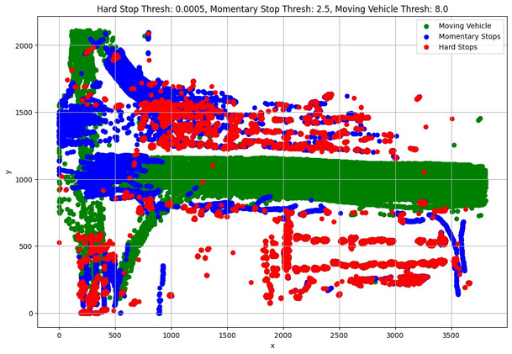
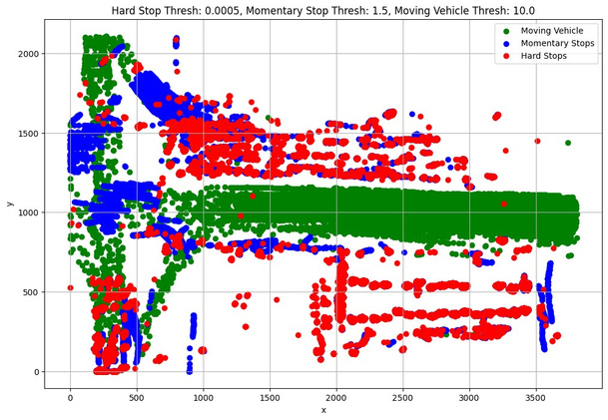
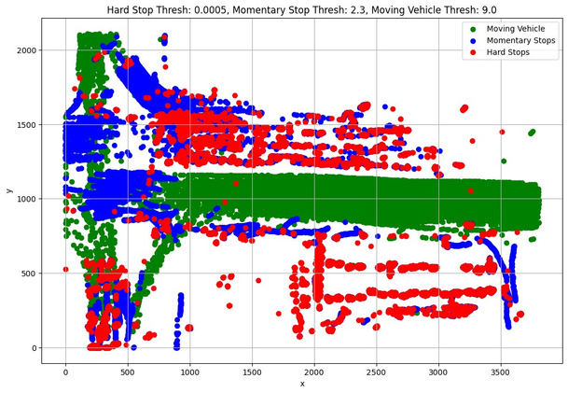
Approach
We’ve plotted the graph for several thresholds values and after comparing these plots with prior beliefs having seen the video, we found these thresholds appropriate.
6

Slide 7
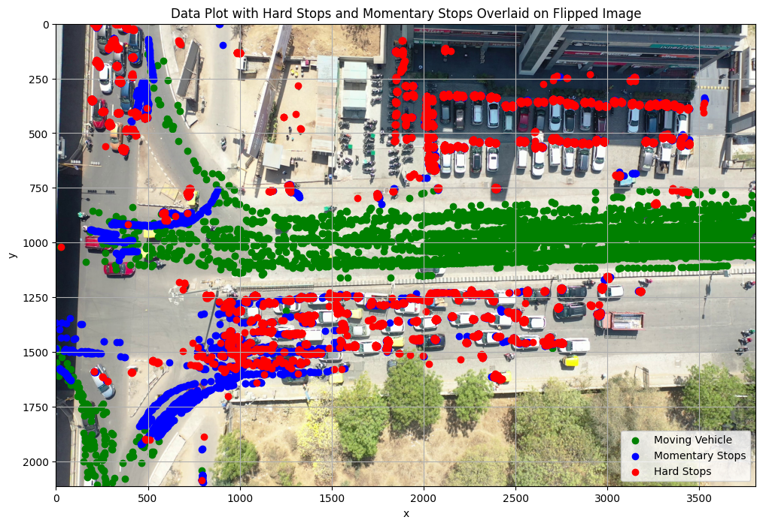
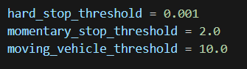
Approach
The Random Forest model was used for classification, leveraging multiple decision trees to improve accuracy and reduce overfitting.
It was trained on distance, velocity, and acceleration, with missing values handled using SimpleImputer.
The dataset was split 80%-20% for training and testing.
Performance was evaluated using accuracy score, classification report, and confusion matrix, and results were visualized to analyze vehicle movement and stop patterns.
7

Slide 8
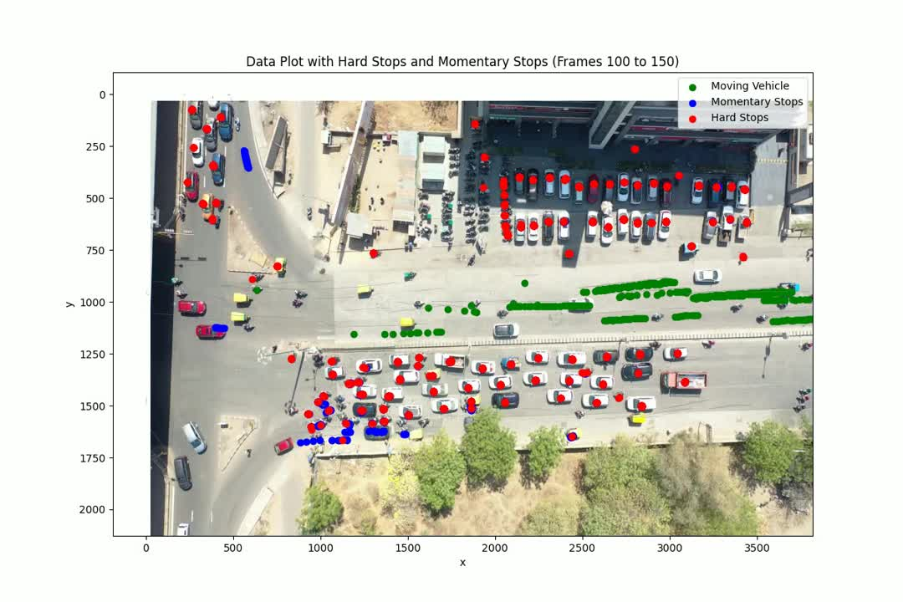
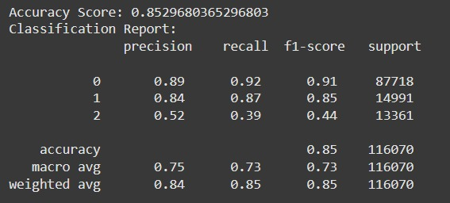
Results
8

Slide 9
Future Work
Exploring Alternative Methods for Data Labeling: Investigate alternative methods to assign labels, anomaly detection, or supervised learning to improve labeling accuracy without relying on fixed thresholds.
Fine-Tuning Threshold Values for Optimal Labeling: Optimize threshold values using data-driven techniques like grid search or Bayesian optimization for more precise classification.
Comparing Model Performance with DBSCAN: Evaluate DBSCAN’s ability to classify vehicle stops without predefined thresholds and compare its accuracy with the current Random Forest model.
9

Slide 10
References
V. Patel, M. Maleki, Mehdi Kargar, J. Chen, and H. Maoh, “A cluster-driven classification approach to truck stop location identification using passive GPS data,” Journal of Geographical Systems, vol. 24, no. 4, pp. 1–21, Jun. 2022, doi: https://doi.org/10.1007/s10109-022-00380-y
Negin Masnabadi, Farhad Hosseinali, and Zahra Bahramian, “Developing a spatial and temporal density-based clustering algorithm to extract stop locations from the user’s trajectory,” Journal of Geospatial Information Technology, vol. 9, no. 2, pp. 105–128, Oct. 2021, doi: https://doi.org/10.52547/jgit.9.2.105.
Y. Hu, Y. Li, H. Huang, J. Lee, C. Yuan, and G. Zou, “A high-resolution trajectory data driven method for real-time evaluation of traffic safety,” Accident Analysis & Prevention, vol. 165, p. 106503, Feb. 2022, doi: https://doi.org/10.1016/j.aap.2021.106503.
G. Y. Oukawa, P. Krecl, and A. C. Targino, “Fine-scale modeling of the urban heat island: A comparison of multiple linear regression and ran dom forest approaches,” Science of The Total Environment, vol. 815, p. 152836, Apr. 2022, doi: https://doi.org/10.1016/j.scitotenv.2021.152836.
10

